Slide 1
Centre for Computational Personalised
Medicine International
Research Foundation
6th Anniversary
of the 1st Sano Seminar on Computational Medicine
Marian Bubak
m.bubak@sanoscience.org
Sano Centre for Computational Medicine
www.sano.science
Krakow, Poland
Krakow, 22 June 2026

Slide 2
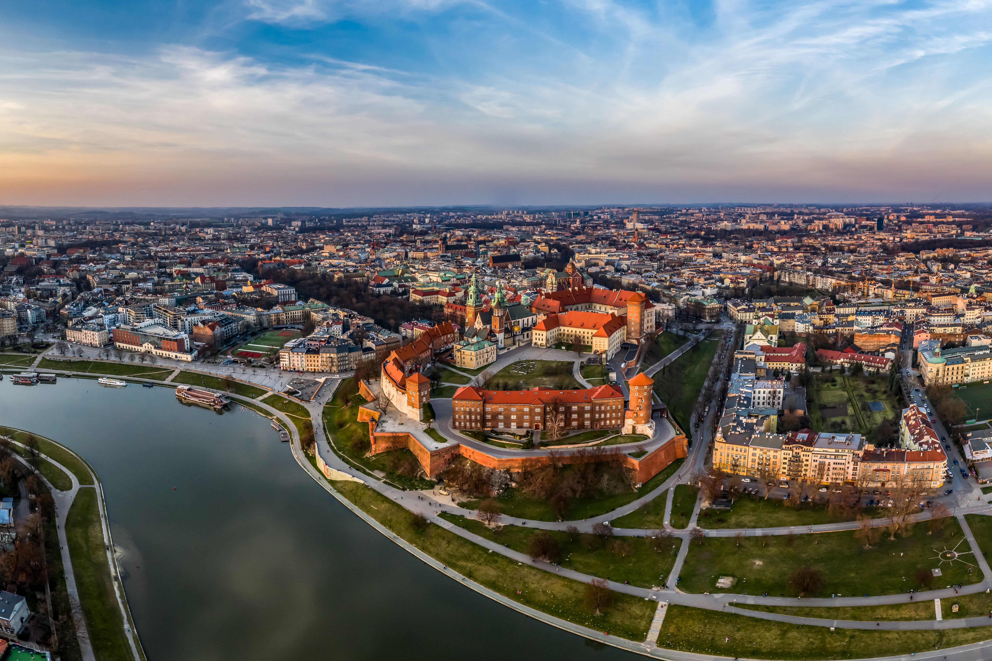

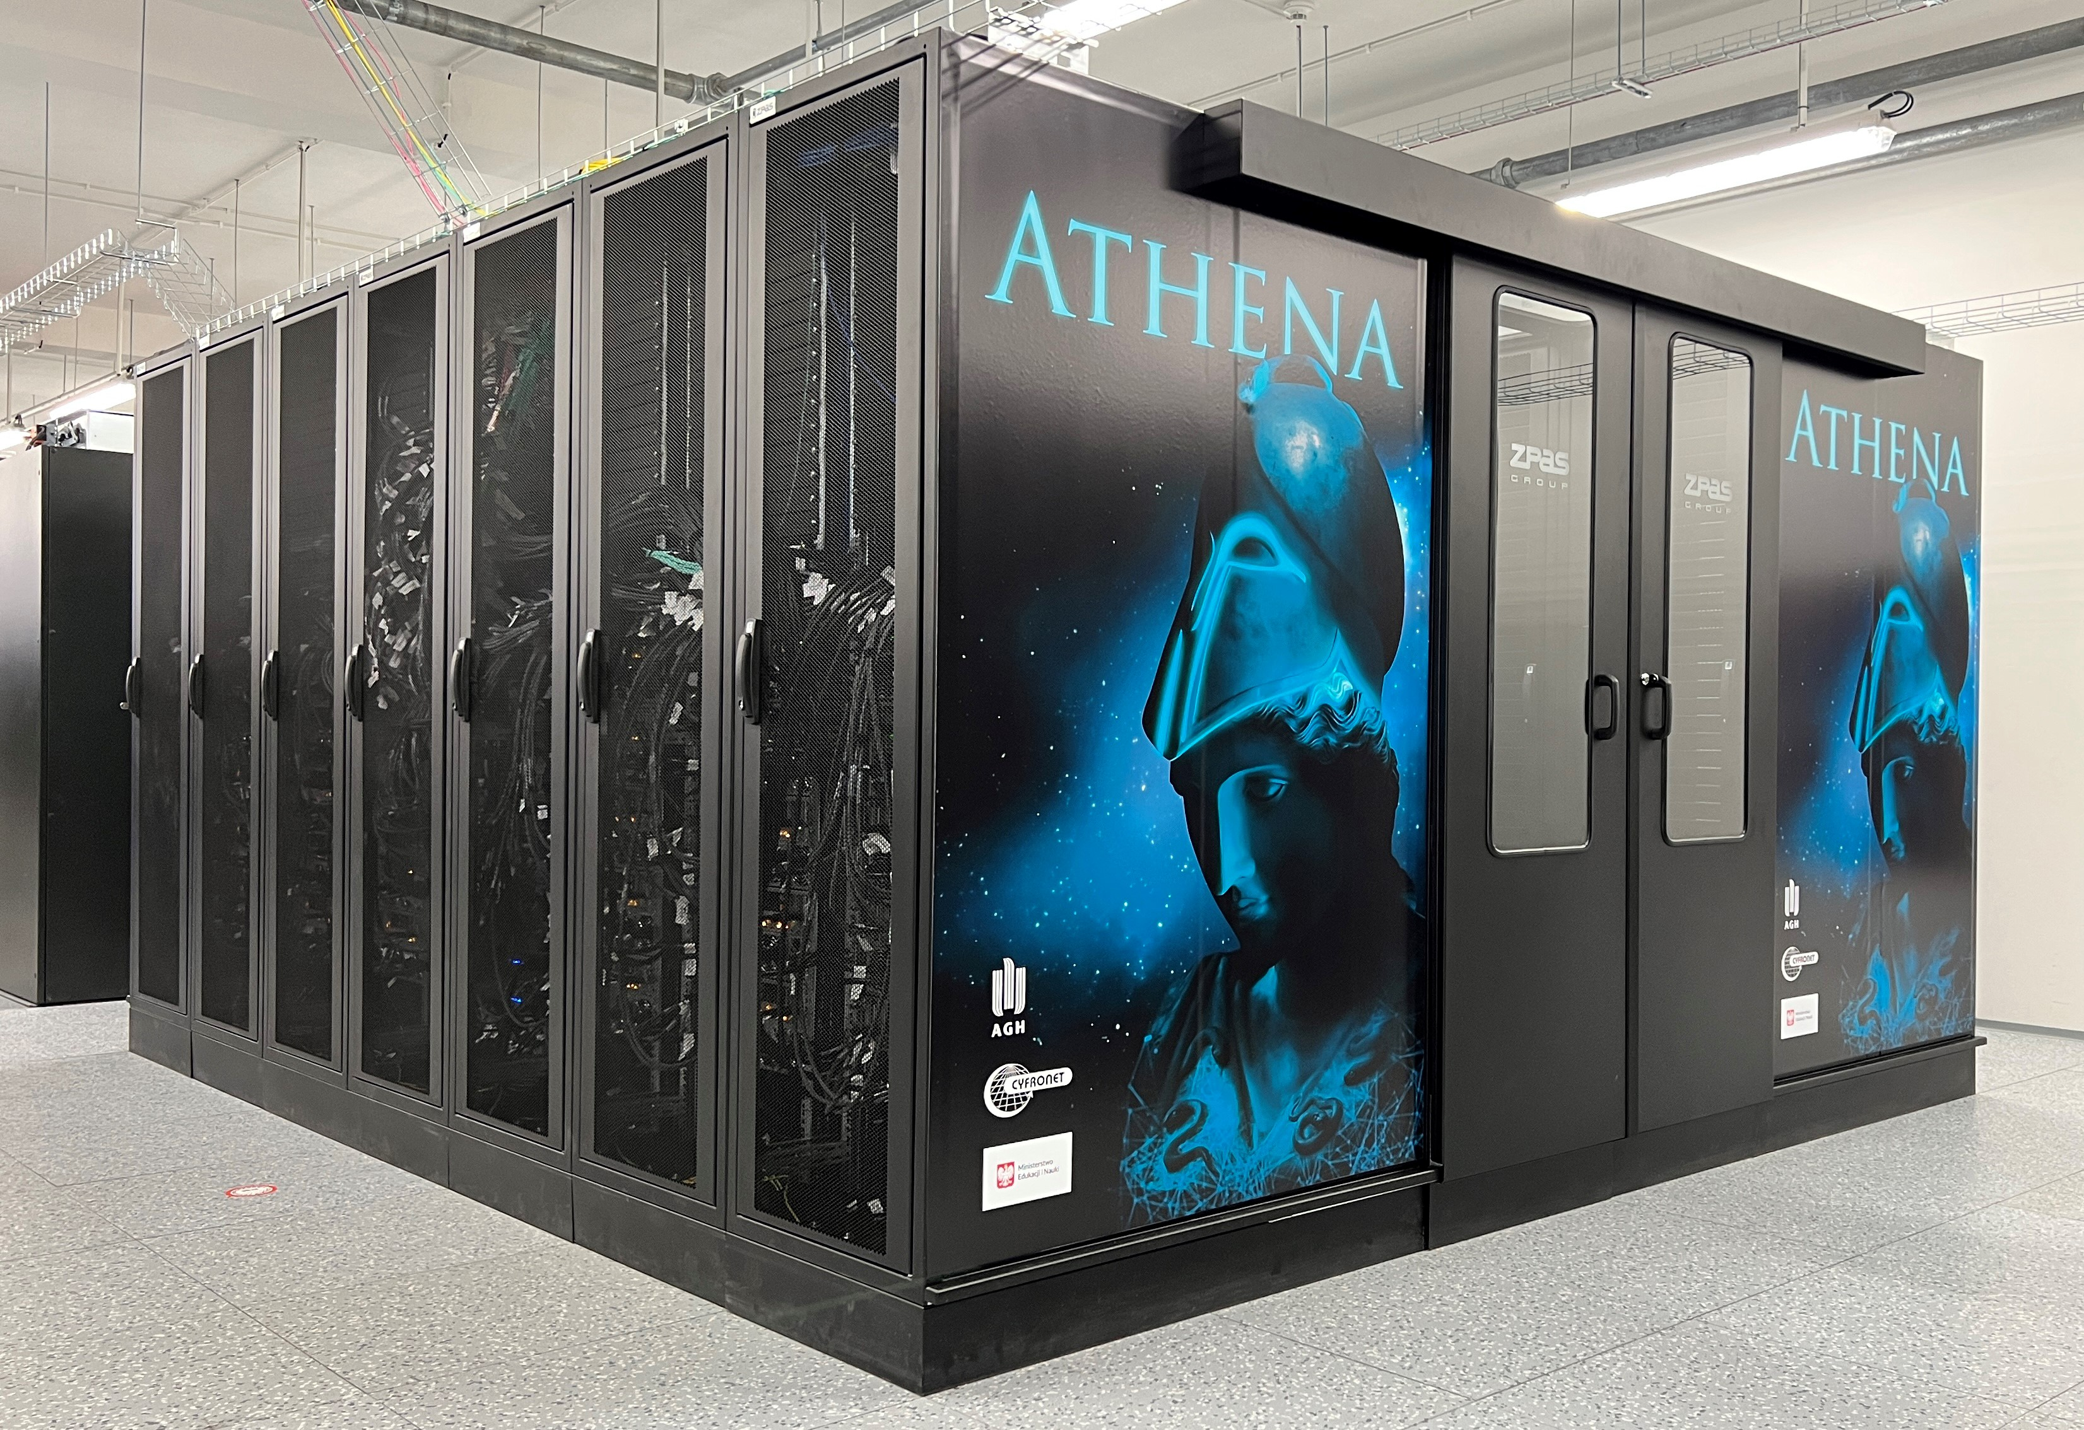
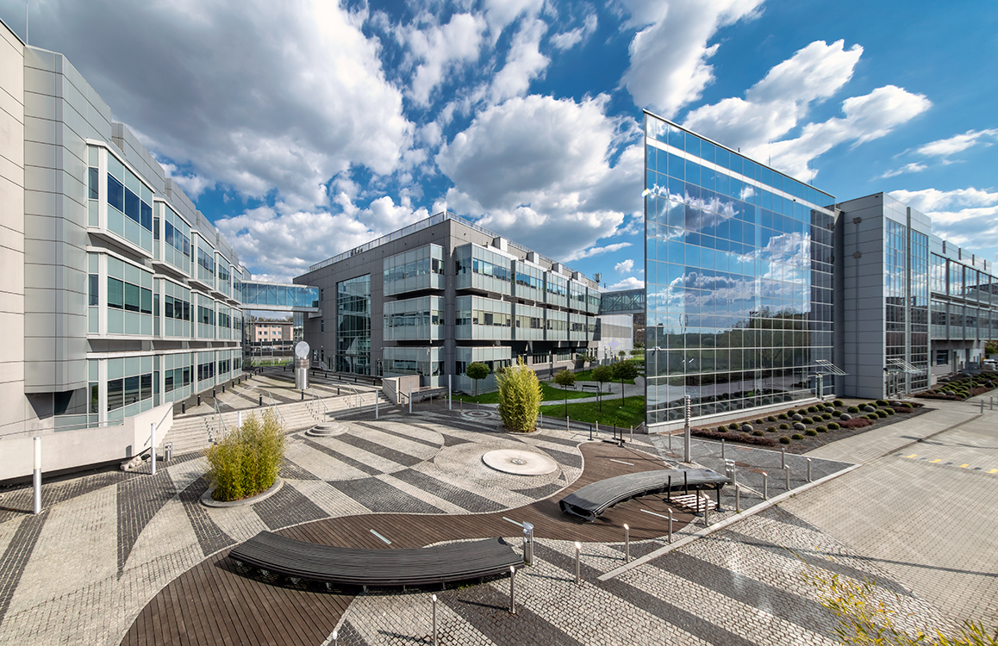
The City of Science
18 higher education institutions, including 8 universities
Sano Centre for Computational Science
Approximately 138,000 students, including 9,600 international students
Over 13,250 academic staff members
Nearly 32,300 graduates annually
11 institutes of the Polish Academy of Sciences
Cluster LifeScience Kraków

Slide 3
Sano Seminars on Computational Medicine
    The 1st – 22 June 2020 – Sabina Lichołai, Collegium Medicum UJ and ACK Cyfronet AGH, the title was Personalized medicine in oncology
    In 20226 Just after 6 years, there are the same dates with day, weekday,
    and months as in 2020
    Today’s seminar number is 193
    Almost always on Mondays at 14.00 CET / CEST
    About 55 minutes for talk and 39 minuts for question. Answers and discussion
    Authors from Sano, our partners, and well recognized speakers
    Abstract and bios on website, recorded version on the Sano Toutube, also for education purposes
    Website: https://sano.science/seminars/
    Be our guest, active participant,
    become a speaker – contact m.bubak@sanoscience.org
3
Notes:
** Clarify which bits of activity are "new" for RP4?

Slide 4

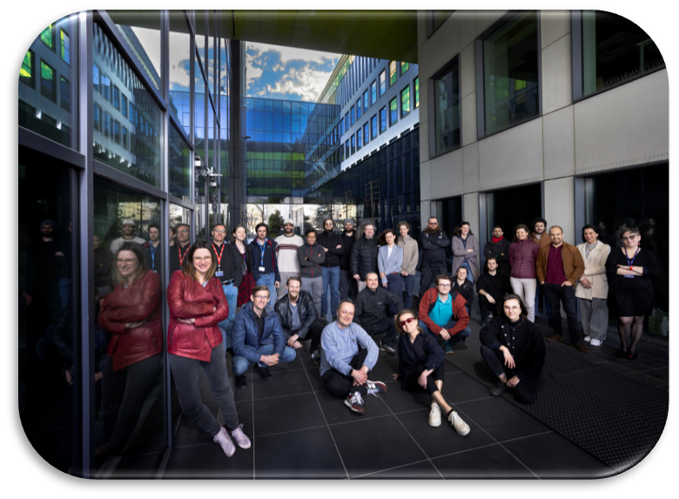
www.sano.science
We research new methods for improving human health with computer technologies and data analysis
The City of Science

